Slide 1
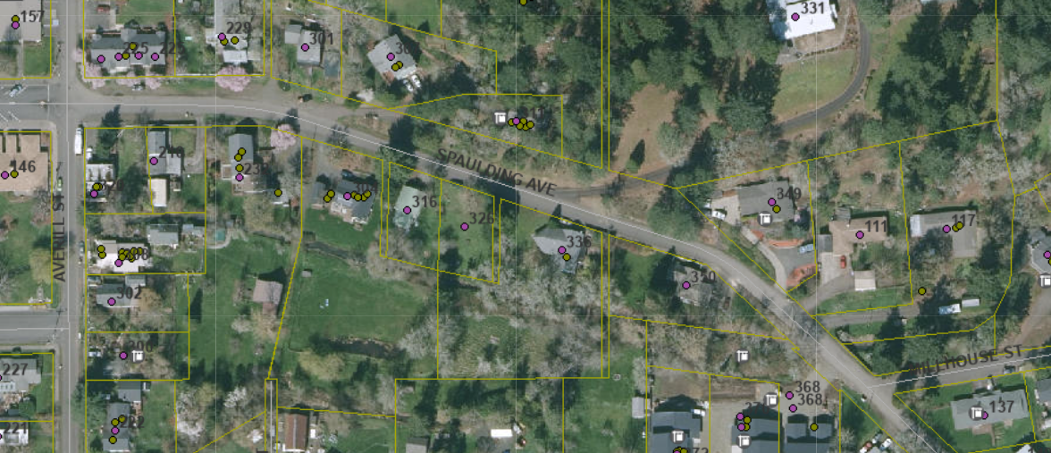
Jim & Sue Smith
Streetlight Request

Slide 2
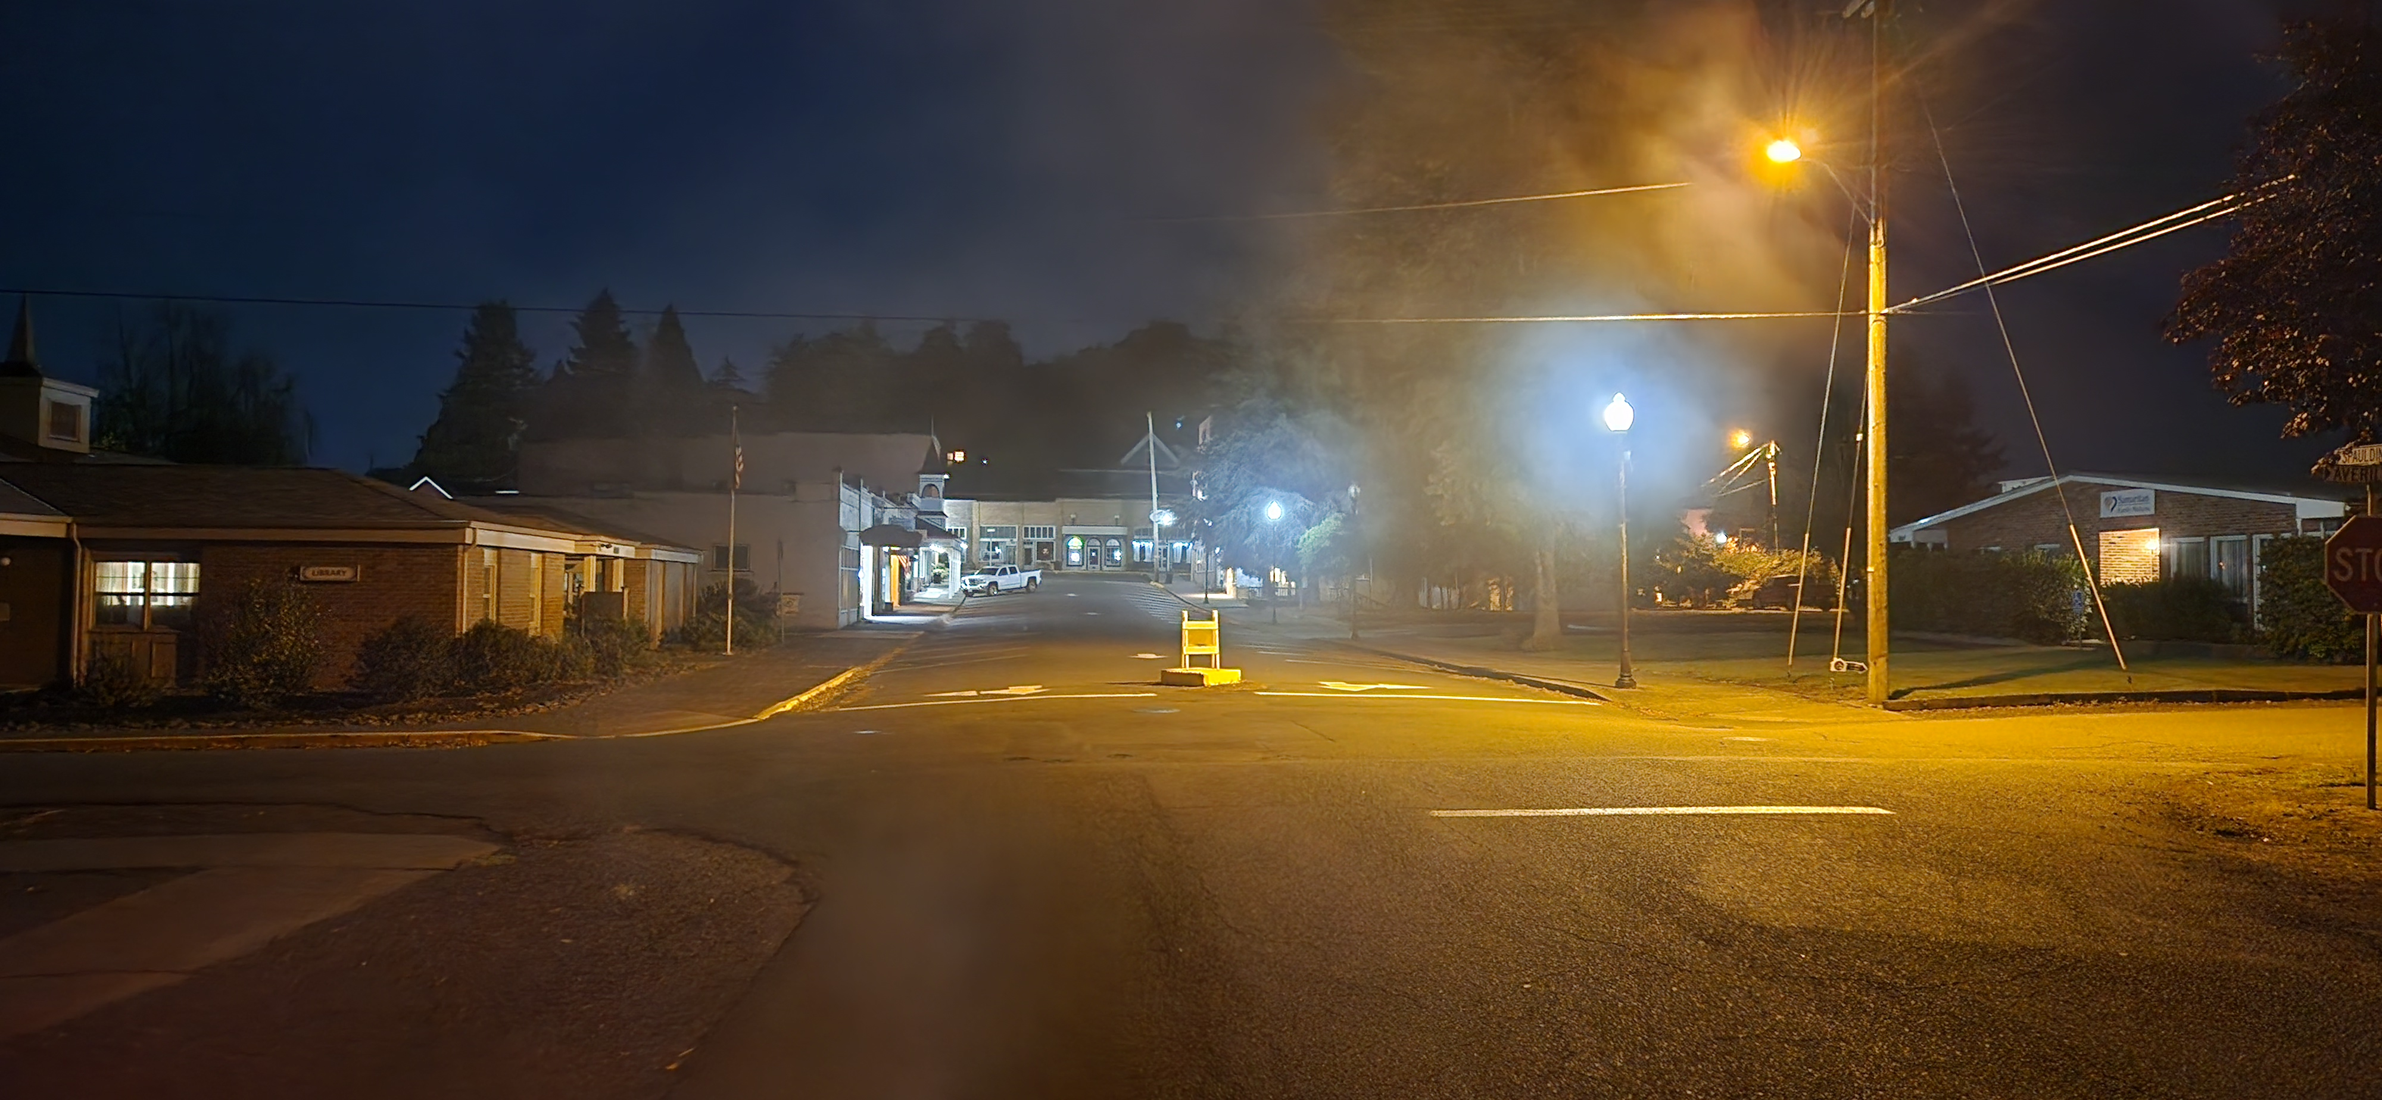
Jim & Sue Smith
Streetlight Request
Averill & Spaulding
Looking West

Slide 3
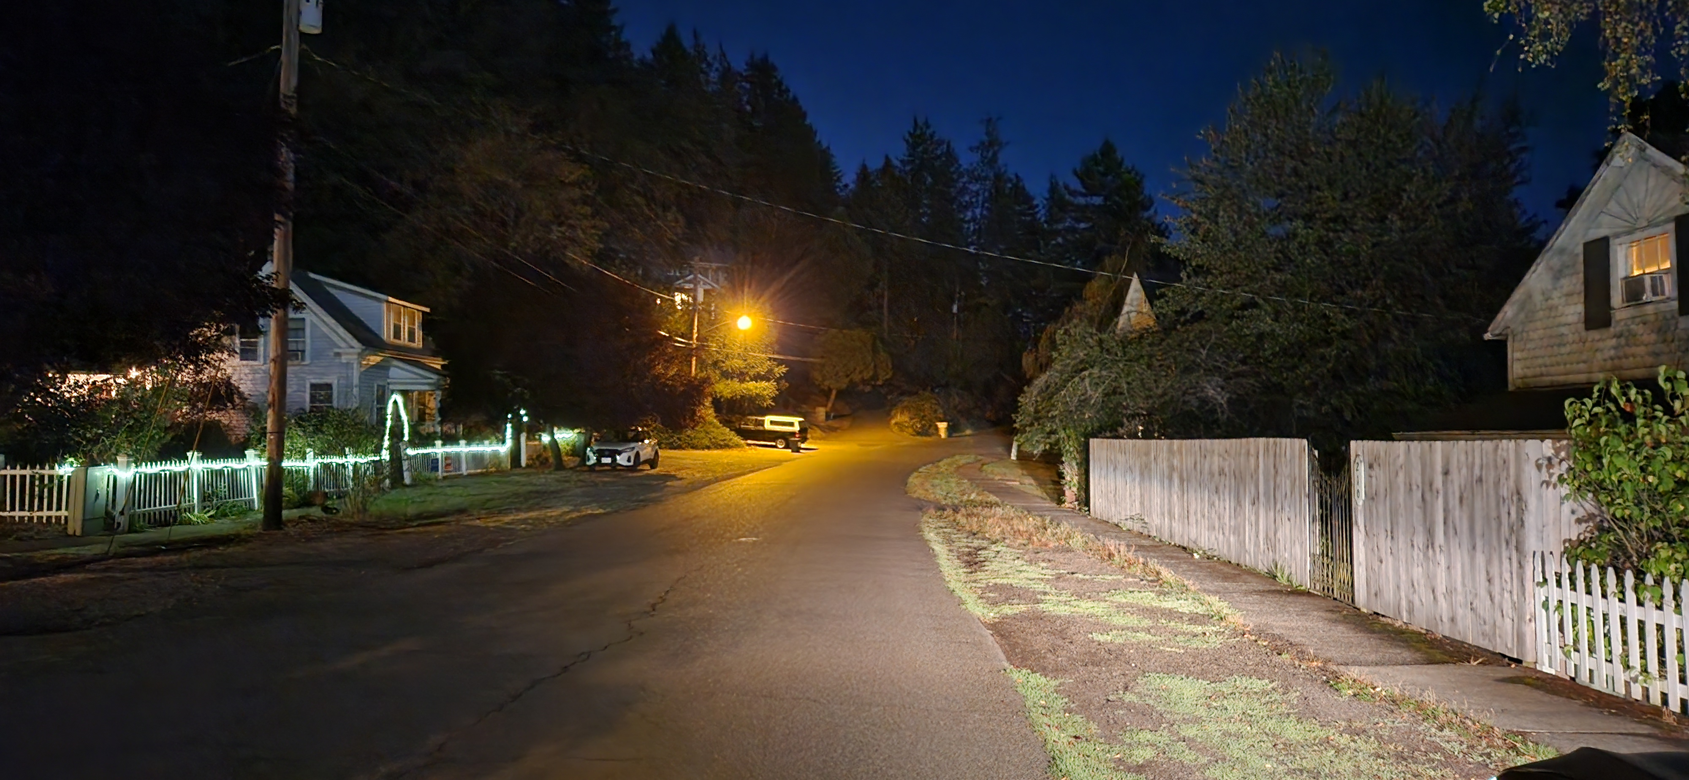
Jim & Sue Smith
Streetlight Request
Averill & Spaulding
Looking East

Slide 4
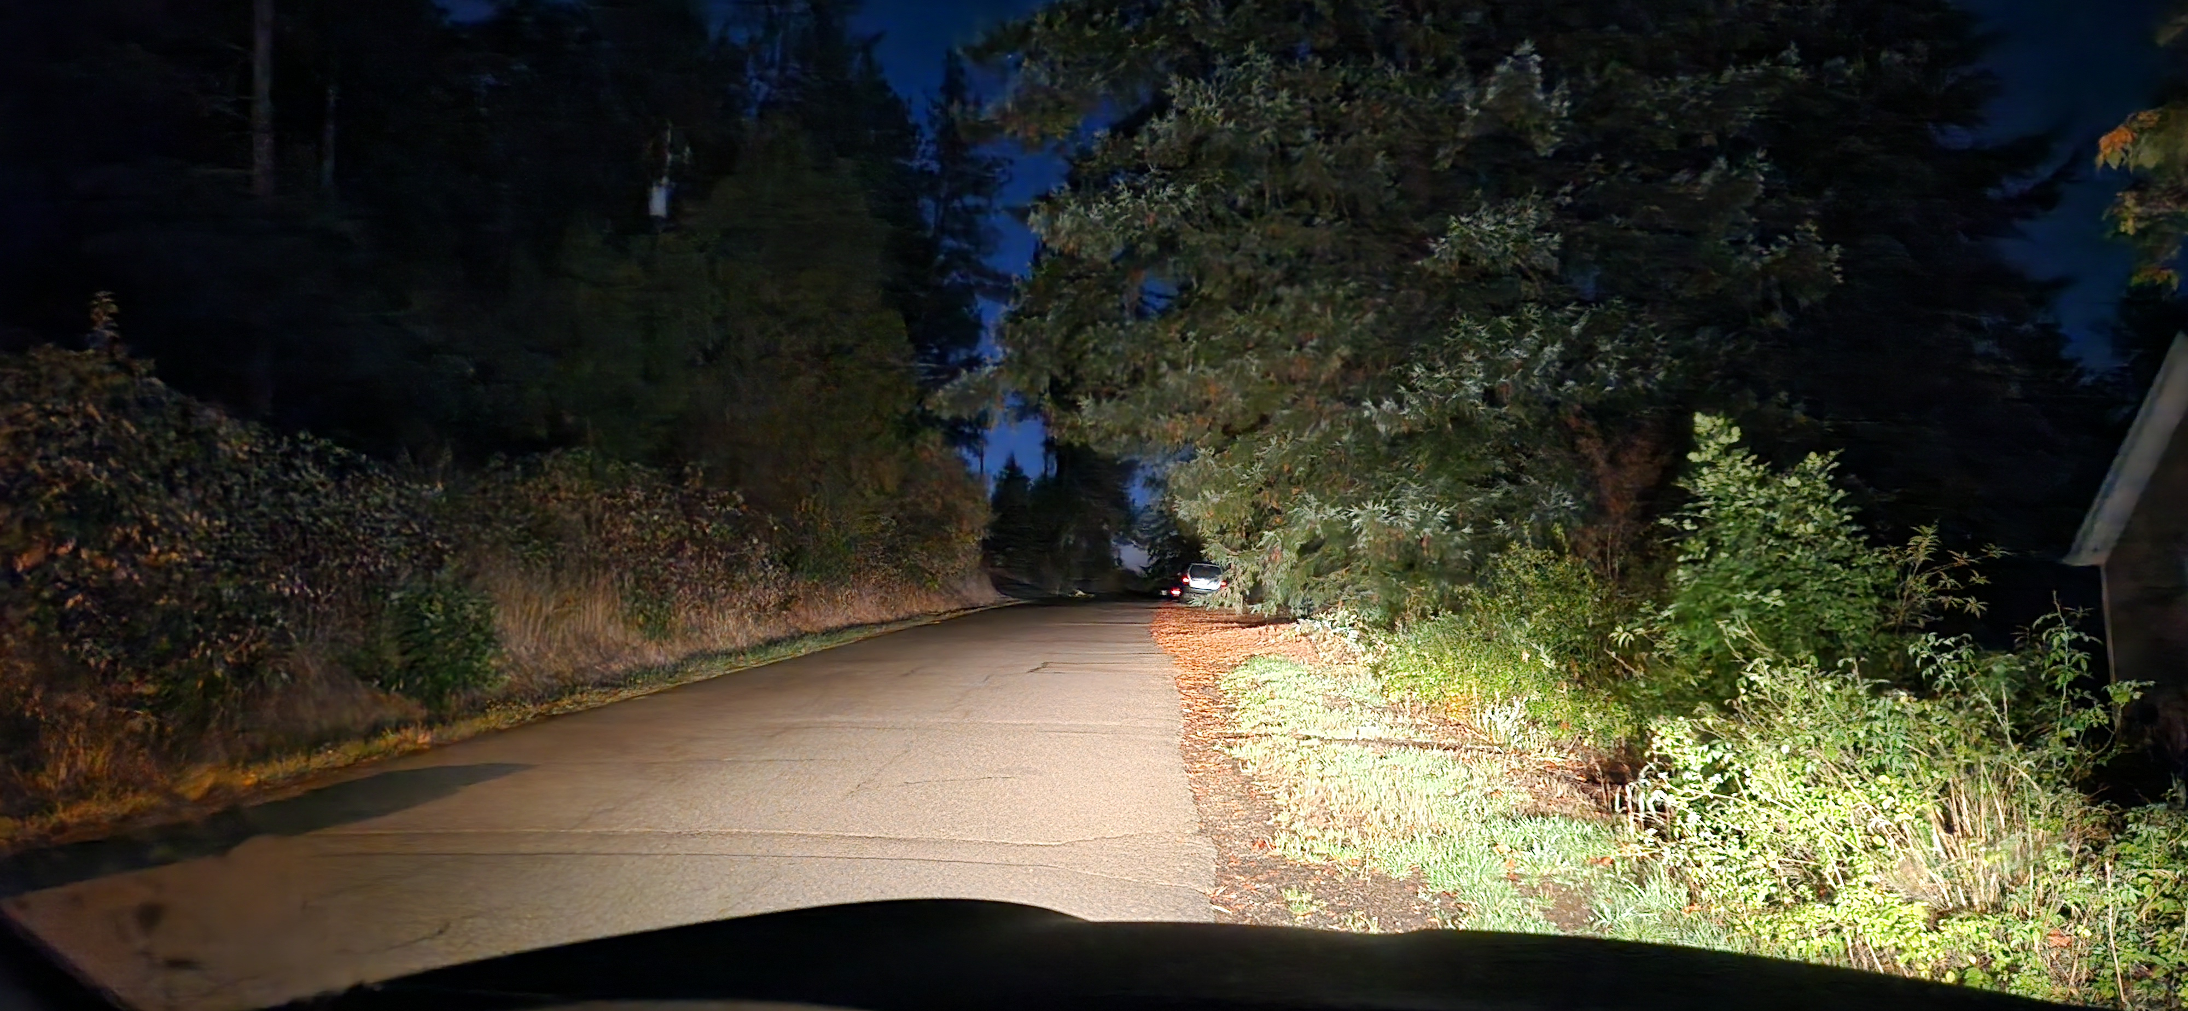
Jim & Sue Smith
Streetlight Request
Spaulding
Looking East past existing light

Slide 5
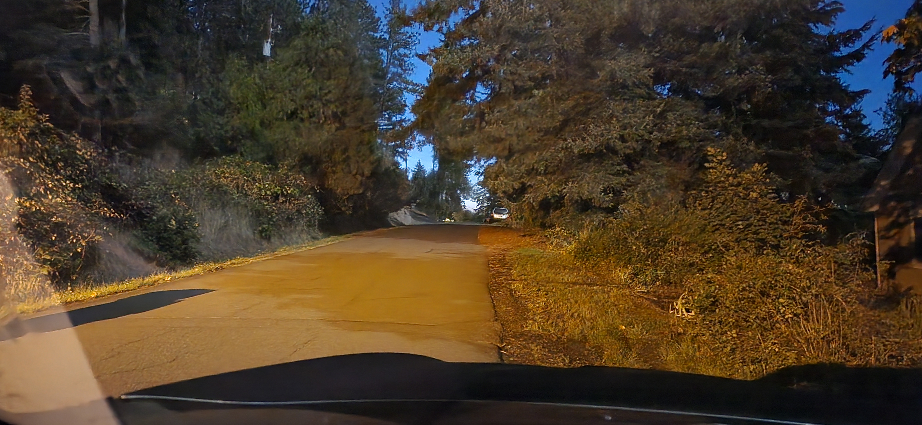
Jim & Sue Smith
Streetlight Request
Spaulding
Looking East past existing light

Slide 6
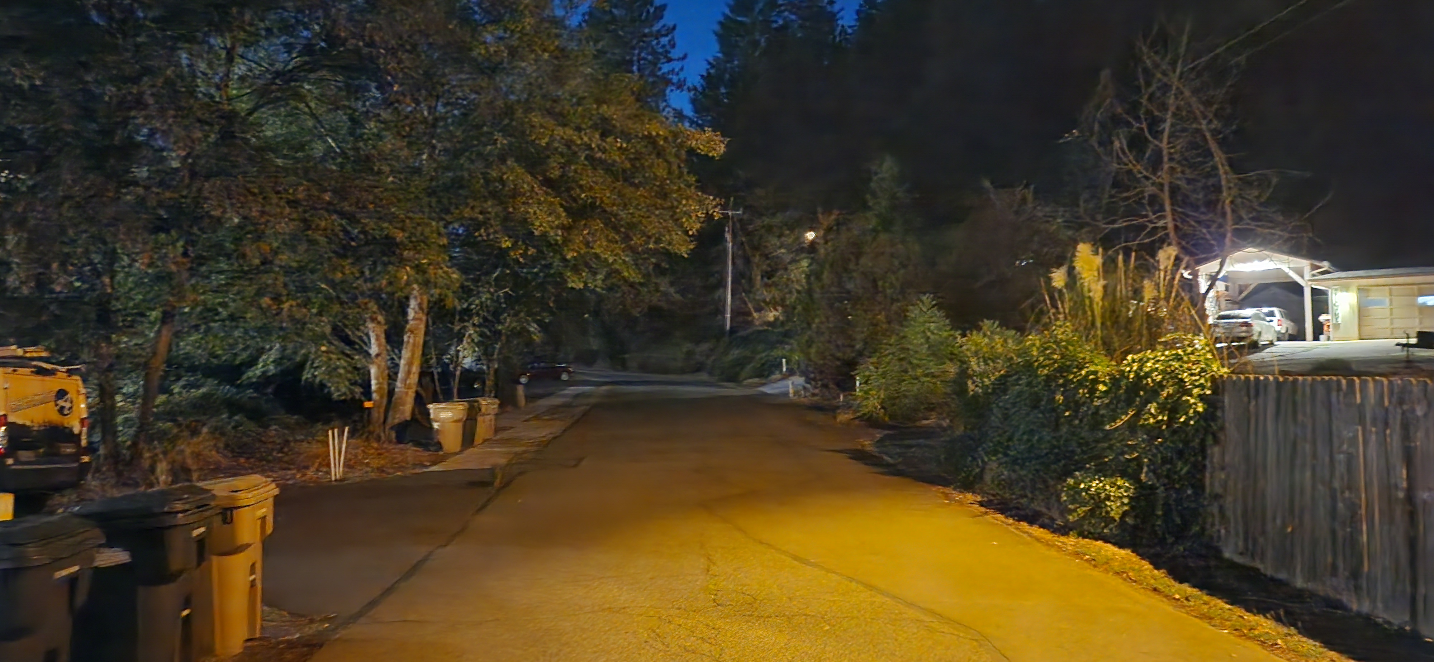
Jim & Sue Smith
Streetlight Request
Spaulding & Millhouse
Looking West

